Slide 1
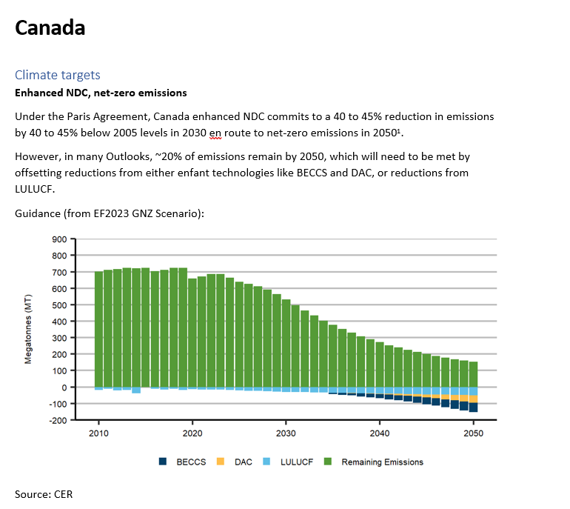

Slide 2


Clean fuel regulations (CFR)
A performance-based supply standard requiring suppliers of gasoline and diesel to reduce the lifecycle carbon intensity of their fuels. Implementation starts in 2022, with the benchmark hitting 4% below 2016 levels in July 2023 before increasing to 15% below 2016 levels by 2030 .
Suppliers achieve compliance by reducing the emissions throughout the liquid lifecycle (CCUS, on-site renewable electricity, co-processing), blending liquids with low-carbon intensity fuels (biofuels, e-fuels, lower-carbon varietals of the same fuel), and investing in end-use fuel switching. Suppliers that do not reduce the intensity of their fuel stream can achieve compliance by purchasing credits from other sources.
Ex: distribution utilities, electric vehicle charging network operators, etc. can generate compliance credits for the chagrining of electric vehicles and sell those credits to liquid fuel suppliers, who are then compliant.
Blending targets:
• CFS will incentivise refineries and fuel suppliers to increase the bioblends in the gasoline and diesel fuel streams
o Ethanol: rise from 8.3% in 2023 to 15% by 2030
o Renewable and biodiesel: rise from 2.6% now to 15% by 2030 (NB: assumptions table states 7% by 2030)
Canada ethanol blending:
Source: USDA
Canada biodiesel + renewable diesel blending:
Source: USDA

Slide 3
Zero-emissions vehicle subsidies
Current federal and provincial subsidies on zero-emission vehicles. Capped purchase and lease subsidy on eligible ZEVs; up to CAD 5 000 for light-duty ZEVs and CAD 200 000 medium- and heavy-duty ZEVs.
Renewable fuels
Current provincial and federal regulations for blending biodiesel, ethanol, hydrogenation-derived renewable diesel, and renewable natural gas (RNG).
Biofuels: Refineries and importers must have an average of 5% renewable fuel content in gasoline and 2% in diesel fuel and heating distillate oil based on volume. The CFS together with provincial level initiatives should push this higher, with 2030 biofuel blends surpassing 15% of the gasoline stream and 7% of the diesel stream, and opportunity to grow higher in more stringent climate scenarios.
RNG: While biogas only makes up 0.36% of Canada’s gas stream in 2021, current mandates could push RNG to ~2% of the gas stream by 2030. Canadian production capacity in 2020 was 6 PJ (per year) and is set to triple to 18 PJ by 2027. Potential for 10 to 15% of marketable gas demand (buildings) to be met with biogas in more stringent climate scenarios.
https://tc.canada.ca/en/road-transportation/innovative-technologies/zero-emission-vehicles
https://www.cer-rec.gc.ca/en/data-analysis/energy-markets/market-snapshots/2023/market-snapshot-two-decades-growth-renewable-natural-gas-canada.html

Slide 4
Zero-emissions vehicle mandate
Canada will introduce sales mandates that ensure that ZEVs constitute 20% of light-duty vehicles (LDVs) sales by 2026, 60% by 2030, and 100% by 2035. For medium- and heavy-duty vehicles (MHDVs), the government is targeting 35% of sales by 2030 and, for those applications wherein it is feasible, a 100% target by 2040.
https://www.canada.ca/en/environment-climate-change/news/2022/03/2030-emissions-reduction-plan--canadas-next-steps-for-clean-air-and-a-strong-economy.html

Slide 5
The Canadian Critical Minerals Strategy
Aims to increase the supply of responsibly sourced critical minerals and support the development of domestic and global value chains for the green and digital economy.
https://www.canada.ca/content/dam/nrcan-rncan/site/critical-minerals/Critical-minerals-strategyDec09.pdf

Slide 6
Hydrogen Strategy for Canada
Vision and roadmap for hydrogen development in Canada. Includes boundaries for the demand and supply potential for hydrogen in Canada.
https://www.nrcan.gc.ca/sites/nrcan/files/environment/hydrogen/NRCan_Hydrogen-Strategy-Canada-na-en-v3.pdf

Slide 7
Canada Aviation Climate Action Plan 2022-2030 (and to 2050)
Sets out a roadmap for a net-zero aviation sector by 2050. Targets are benchmarked by a BAU scenario wherein the aviation sector continues to operate at 2019 efficiencies out to 2050.
https://tc.canada.ca/sites/default/files/2022-11/canada-aviation-climate-action-plan-2022-2030.pdf

Slide 8
Energy Outlooks
CER published a long-term demand and supply Outlook to 2050 for Canada in Q2 2023. It includes a Current Measures Scenario (CMS) that can benchmark REF and two Net-Zero Scenarios that can benchmark TGT.
Scenarios Description
Macroeconomics
Population assumptions are taken externally from the United Nations Department of Economic and Social Affairs (UNDESA) World Population Prospects 2022 projection. The High projection is chosen for Canada to reflect its pursuit of a growing population via immigration increases. This sees population reach 49 million by 2050 and approach near 53 million by 2060.
GDP projections are made internally via a Swan Solow growth model. However, the Outlook until 2027 uses IMF projections to align with best-available expectations for the Canadian and global economies. Under this framework, real GDP grows at a CAGR of 1.7% over the Outlook period.
GDP and population are assumed to stay the same in both scenarios.
The Reference scenario
REF for Canada is a continuation of existing energy demand and supply trends subject to the influence of policy in place at the time of analysis.
On the demand side, energy efficiency and fuel efficiency continue to improve gradually but in excess of historical trends due to rising carbon compliance costs and the clean fuel regulations targeting gasoline and diesel fuel consumption.
https://www.cer-rec.gc.ca/en/data-analysis/canada-energy-future/2023/
https://population.un.org/wpp/

Slide 9
Transport (Reference scenario)
Existing LDV and HDV standards continue out to 2025 and 2028, respectively, improving the efficiency of the passenger and freight fleets.
Electrification of the transport sector accelerates due to EV subsidies but is limited by a lack of coordinated policy incentives and supporting infrastructure such as charging stations. The transport sector does not reach the stated goal of half of all new passenger car and light truck sales being zero emissions by 2030.
The CFS will increase ethanol blend to at least 15% by 2030 and diesel blend (biodiesel and RND) to 7% by 2030.

Slide 10
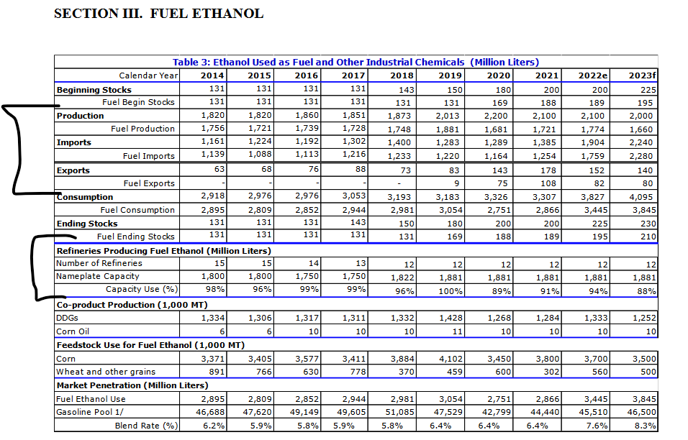
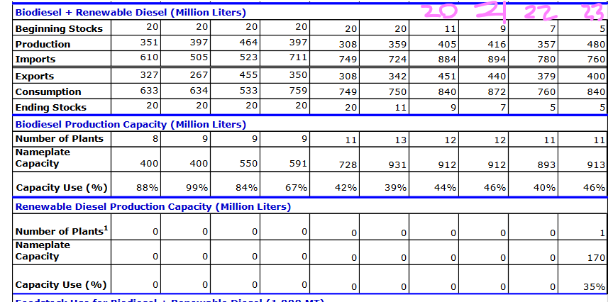
Source: USDA
Biodiesel:
Canada exports 88 to 99% of domestic production and imports almost all of its domestic demand requirements (see below)
Source: USDA
Production capacity is 840 ML in 2020, 1083 ML in 2023, and is set to rise north of 4000 ML by 2027; assume production rises in tandem with this increase.
Assume that half of growth in biofuel demand in diesel stream is met by domestic production, with the rest being met by imports and the remaining production exported.
https://www.cer-rec.gc.ca/en/data-analysis/energy-markets/market-snapshots/2023/market-snapshot-new-renewable-diesel-facilities-will-help-reduce-carbon-intensity-fuels-canada.html

Slide 11
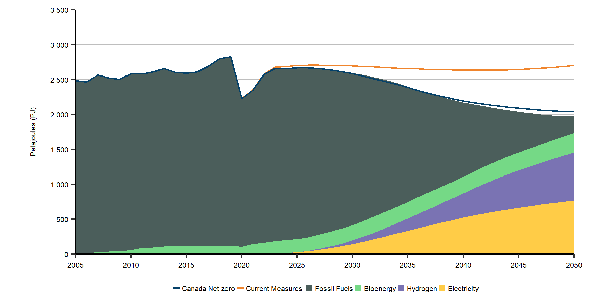
Transport Target
Canada reaches the following ZEV targets for road transport:
• 20% of light-duty vehicles (LDVs) sales by 2026, 60% by 2030, and 100% by 2035.
• 35% of sales by 2030 for MDV/HDVs and 100% by 2040, where possible.
Shares of total ZEVs vehicles on the road approach close to 100% by 2060.
Other road guideposts from the EF2023 GNZ:
• Freight
- Hydrogen use grows to 0.5 Mt(60PJ) in 2030 and 5 Mt (600PJ) by 2050 (hydrogen is 120pj per mt so 0.5mt is 60pj hydrogen, 5mt is 600pj)
- Electricity grows to 90 TWh(324 PJ) by 2050 (1 TWh is 3.6PJ, so 90 is 324 PJ- remember this is only freight)
• Renewable diesel
o Renewable diesel blend grows from 7% in 2030 to 35% by 2050
• Ethanol
o Blend grows from 15% in 2030 to 20% by 2050
Aviation reduces its emissions by 70% in 2050 below the BAU case where aviation energy efficiency is held fixed at 2019 levels. Improved aircraft and operational efficiencies make up 23% of this reduction; sustainable aviation fuels, a combination of biofuels and hydrogen, make up the other 47%. The remaining 30% emissions are offset using out of sector reductions (offsets).
Canada’s GNZ transport fuel mix for comparison purposes:
Source: CER

Slide 12
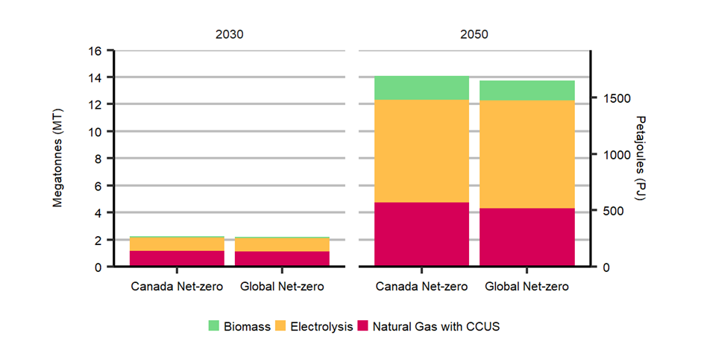
Hydrogen
Assume that Canada is self-sufficient in hydrogen (not a hydrogen importer). Hydrogen exports occur, but limit exports to ~20% of hydrogen production or ~25% of domestic demand.
Should exports of hydrogen be limited to dedicated offshore wind fields?
Assume that electrolysis grows to meet two-thirds of hydrogen supply, with natural gas equipped with CCS supplying the rest.
Guidance from the CER:
Source: CER

Slide 13
Refining
Oil products
Canada is unlikely to see another refinery built over the projection period.
Align refinery retirements over the projection period as domestic and global demand for oil products declines.
Feedstock sourcing: Canada turns to higher domestic sourcing shares (up to 50% by 2050).
Biofuels
Ethanol:
Assume that capacity and production follow the relative demand trajectories, which are likely to be lower despite higher blending (20% ethanol in the gasoline stream versus 15% in REF) due to electrification reducing gasoline demand, with the remaining ethanol supply met from imports.
Sustain production by reducing import share of ethanol supply sourcing (from 100% now to 50% by 2050)
Biodiesel:
Production rises in line with higher biofuel blending requirements (35% by 2050)
Assume that three-quarters of growth in biofuel demand in diesel stream is met by domestic production, with the rest (25%) being met by imports and the remaining production exported.
Source: USDA

Slide 14
 | Reference | Target
Macro | Population: UNDESA “High” GDP: APERC macro model
Key Assumptions for the Canada
Transport | EV sales increase due to subsidies, but stock remains mostly ICEs (look to EF2023 for guidance on fuel shares) Fuel economy improves due to existing LDV (2017 to 2025), HDV (2017 to 2027) emission standards CFS pushes ethanol blend of gasoline to 15% (volume) by 2030 and biofuel blend to 7% of diesel by 2030 | LDV ZEV sales hit 20% by 2026, 60% by 2030, 100% in 2035 Stocks of ZEVs approach 100% by 2060 M/H DV ZEV sales hit 35% by 2035, 100% by 2040 for possible applications, with some role for hydrogen vehicles Diesel will remain for some freight applications Ethanol blend grows to 20% by 2050, biofuel blend in diesel grows to 35% by 2050 Aviation achieves 70% reduction from BAU levels via operational efficiency (23%) and sustainable aviation fuel adoption (47%), with offsets achieving the rest Some shifting towards more efficient transport modes
Hydrogen Supply | Self-sufficient in hydrogen supply Domestic production of blue (SMR w/ CCUS) and green (electrolysis) hydrogen and ammonia No exports of hydrogen | Self-sufficient in hydrogen supply, but begins to export about a fifth of domestic production in the late 2030s Electrolysis grows into dominant technology in the 2040s Biomass??????

